Slide 1
DHANALAKSHMI SRINIVASAN COLLEGE OF ENGINEERING AND TECHNOLOGY
Marine Mate: Aqua Metadata Exploration And Fish Species Prediction Using Deep Learning.
DOMAIN: Web Application /AI

Slide 2
DHANALAKSHMI SRINIVASAN COLLEGE OF ENGINEERING AND TECHNOLOGY
REG. NO. - NAME OF THE STUDENTS:
GUIDED BY
310520104119 - Sivabala R
310520104080 - Nithish Kumar S
310520104130 - Surya K S
310520104077 - Naveen R
Ms. Abhinaya S , M.E

Slide 3
ABSTRACT
Our project, Leveraging Artificial Intelligence (AI) for Marine Resource Management in Southern India aims to address the critical need for efficient utilization of coastal resources in India's emerging economy. Focused on Southern India, particularly starting from Chennai, our endeavor emphasizes oceanography, aquaculture, and geographical features.
We recognize the challenges in analyzing ocean environments and protecting endangered species. To tackle these issues, we've developed a web-based platform that integrates AI tools and comprehensive data to enhance the user experience. Our goal is to establish a centralized hub for oceanic information, driving sustainable development and conservation efforts in the region.

Slide 4
OBJECTIVE
1. Efficient Marine Resource Utilization: Utilize AI and web technologies to optimize the use of marine resources, focusing on coastal regions like Southern India.
2. Promote Conservation Efforts: Raise awareness and facilitate action for marine conservation through AI-powered tools and dedicated platform features, fostering sustainable practices for future generations.
3. Enhance User Understanding: Provide comprehensive insights into marine ecosystems through interactive maps, real-time weather updates, and species identification, it empowering users to make informed decisions and contribute to oceanic sustainability.

Slide 5
EXISTING SYSTEM
The Tamil Nadu Maritime Board website, the primary maritime information source, lacks comprehensive data on key sectors such as oceanography, aquaculture, and transportation.
Despite offering basic functionalities like map images, the website falls short in providing detailed insights into crucial maritime aspects.
The absence of information on endangered ocean species in Tamil Nadu's coastal regions hampers conservation efforts, emphasizing the need to augment the existing system with comprehensive data, improved accessibility, and addressing critical information gaps.

Slide 6
PROPOSED SYSTEM
In our enhanced website, we've introduced several key features to its utility and user experience.
These include fish prediction functionalities, an AI chatbot for seamless user interaction, live weather updates for real-time information, and metadata concerning endangered and vital ocean species.
Furthermore, users can now access comprehensive data on ports, sea borders, and major seas, all in one centralized platform. Live updates on port news further enrich the user experience, making our website a go-to resource for comprehensive maritime information and real-time updates.

Slide 7
LITERATURE REVIEW
YEAR - TITLE | METHODS | ADVANTAGES | DISADVANTAGES | HOW THIS REFERENCE GIVES SCOPE FOR PROPOSED WORK
2022- Annual Overview of marine casualties and incidents. | Data identifying | Identifying areas for improvement in maritime safety, and informing regulatory and operational decisions within the maritime industry | Human Error, Manual data entry. | We implemented in our website with metadata.
2020. Role of Web-based Platforms in Marine Conservation: | Marine Conservation | Community building | Outreach, Marine conservation issues. | We implemented marine conservation issues and Endangered species identification.
2010-Aquaculture global status and trends | Data, information handling | Employment opportunities, diversification of income sources. | Social impact, Regulatory Challenges. | We added live updates, employment opportunities and awareness about endangered species in tamilnadu coastal regions.

Slide 8
TECHNOLOGIES USED
OPERATING SYSTEM : Windows 7/XP/8/10/11
FRONT END : HTML, CSS, JAVASCRIPT
SERVER SIDE PROGRAMMING LANGUAGE : Python

Slide 9
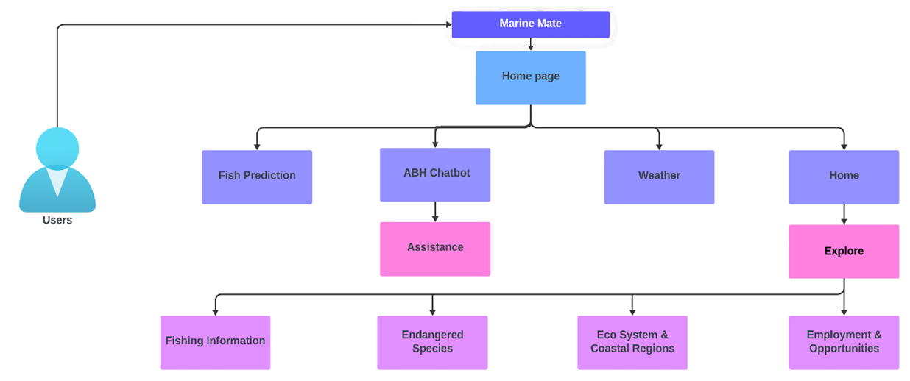
USECASE DIAGRAM

Slide 10
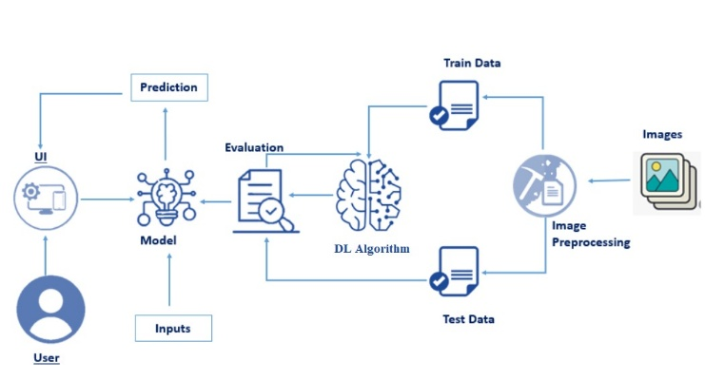
ARCHITECTURE DIAGRAM
Fish Prediction

Slide 11
CNN
CNNs are deep neural networks designed for processing structured grid data like images.
COMPONENTS:
Convolutional Layers: Extract features using learnable filters.
Activation Functions: Introduce non-linearity .
Pooling Layers: Down sample feature maps while preserving important information.
Fully Connected Layers: Aggregate features for making predictions.

Slide 12
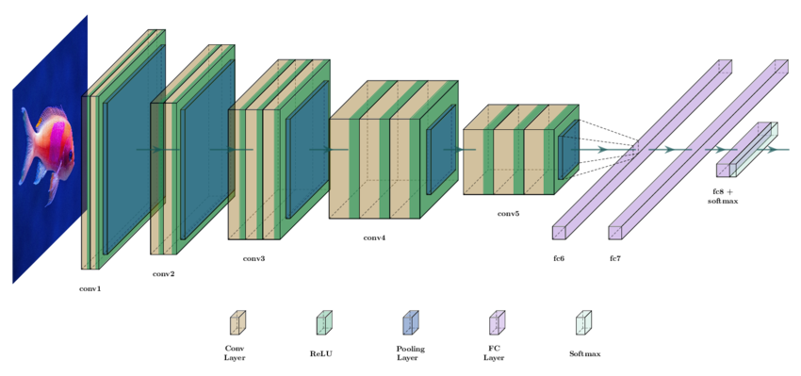
CLASSIFICATION DIAGRAM OF CNN

Slide 13
MODULES
Important Species
Endangered Species
Chatbot
Maps and Ports
Weather Integration
Fish Prediction

Slide 14
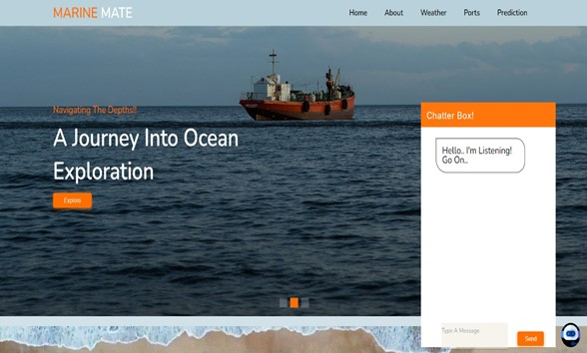
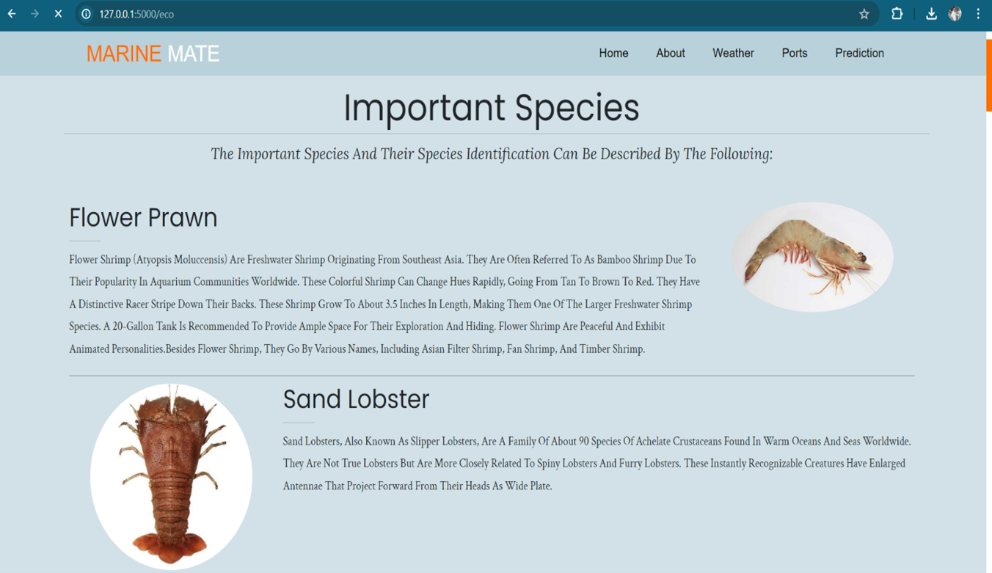
OUTPUTS
- Home Page
- Important Species Page

Slide 15
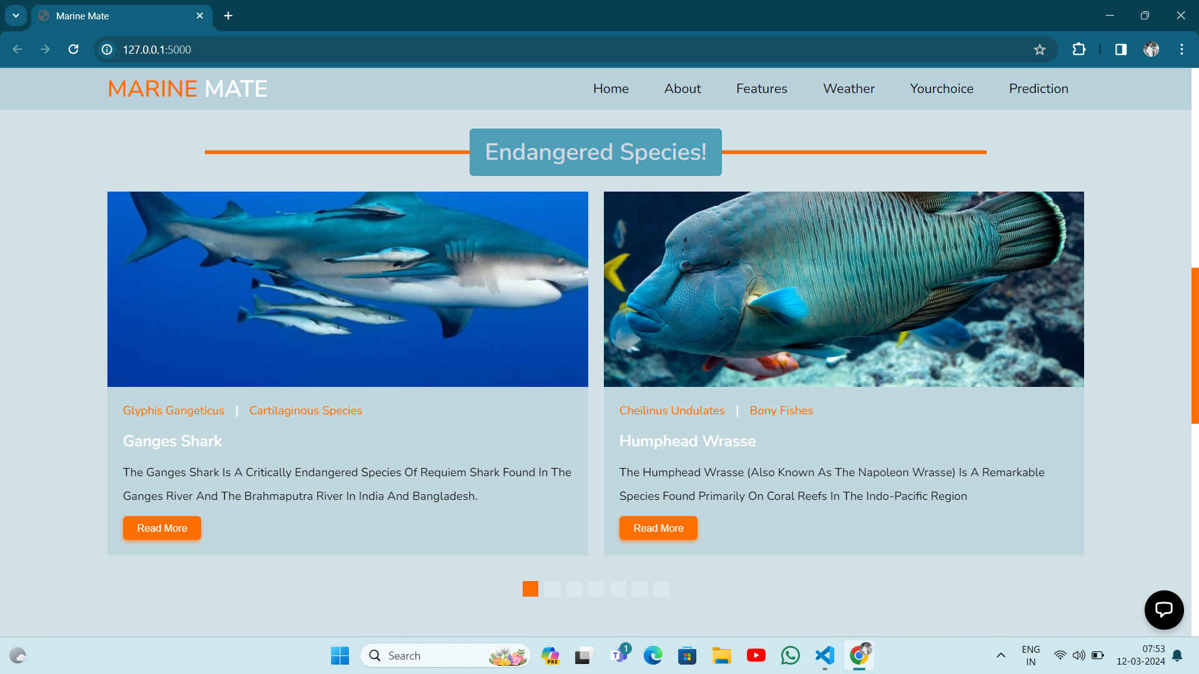
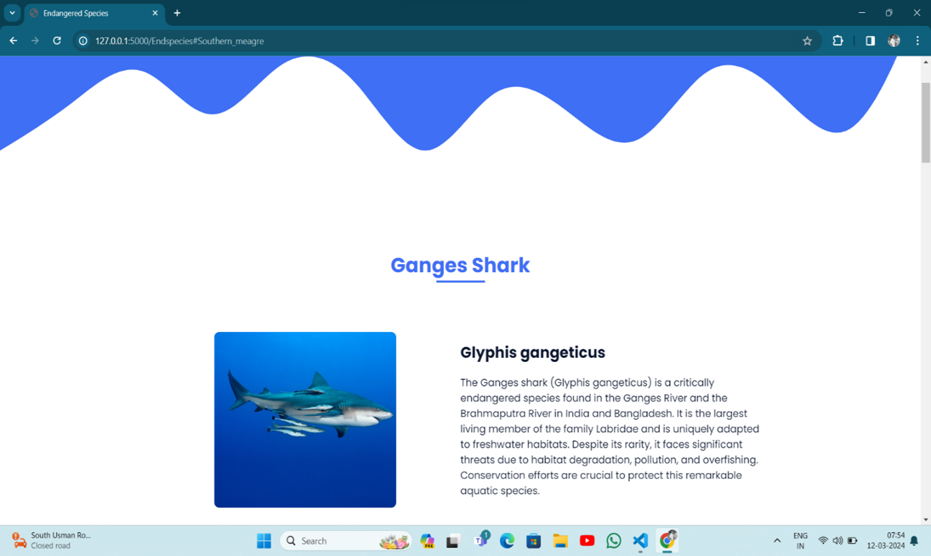
OUTPUTS
- Home Page(Endangered Species Section)
-Endangered Species Page

Slide 16
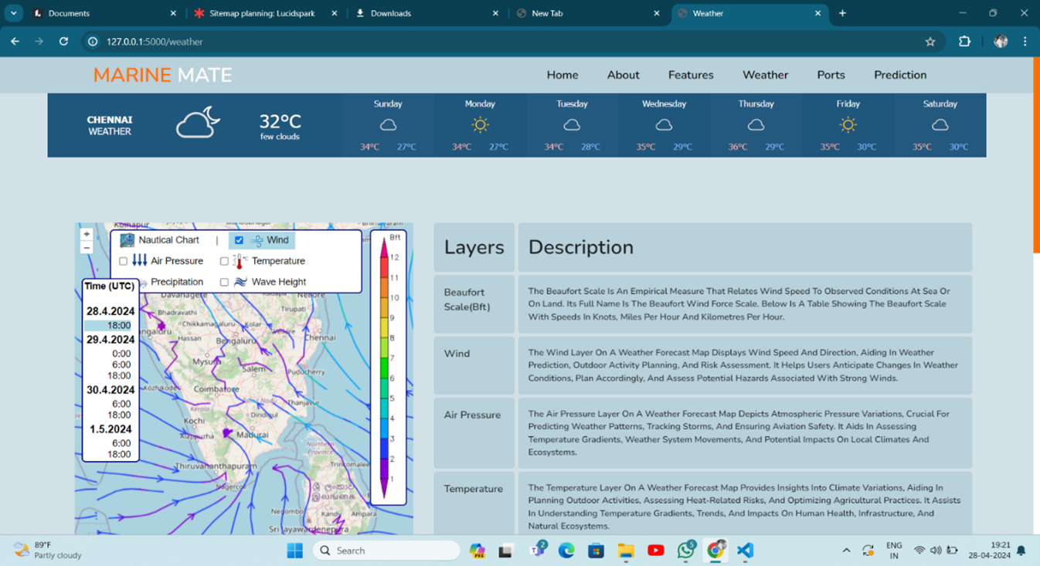
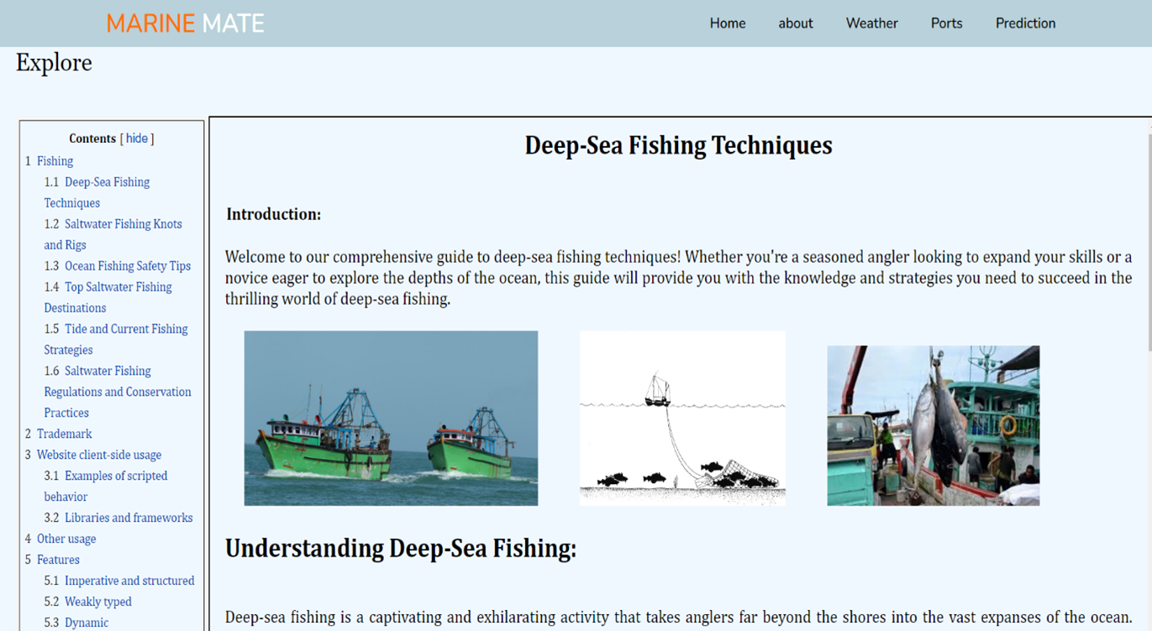
OUTPUTS
- Weather Page
- Explore Page

Slide 17
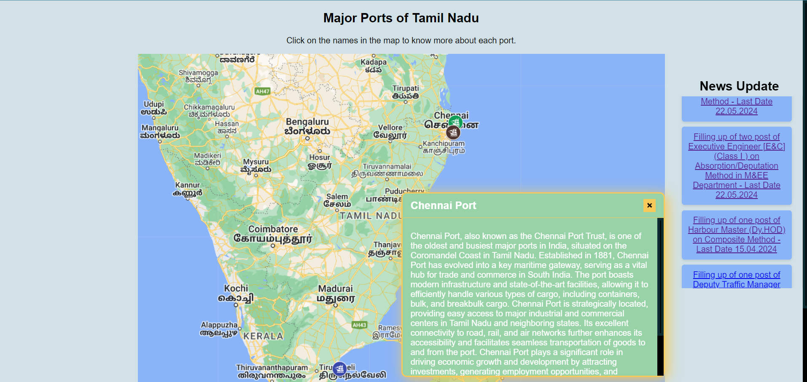
OUTPUTS

Slide 18
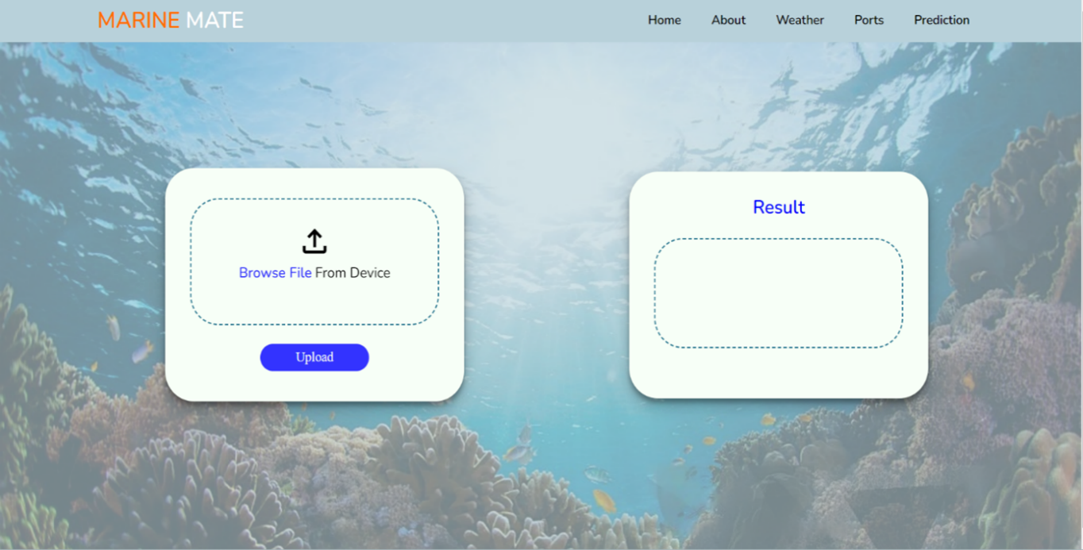
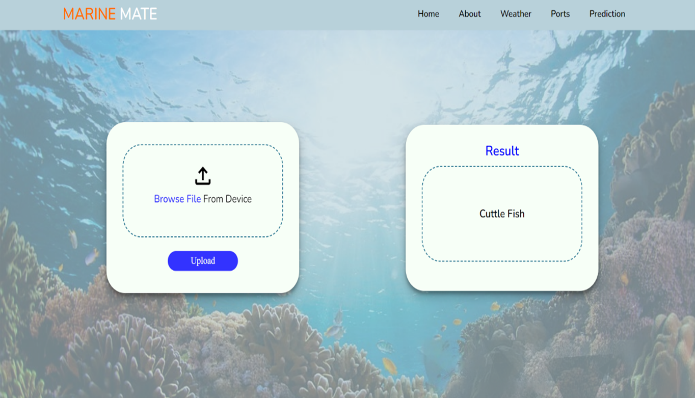
OUTPUTS
- Fish Prediction Initial UI
- Fish Prediction After Prediction

Slide 19
CONCLUSION
Our web-based platform represents a significant leap forward in sustainable marine resource management, especially in India's coastal areas. By merging Artificial Intelligence (AI) with web technologies, we offer users invaluable insights into marine ecosystems, starting with Chennai in Southern India. With features like fish prediction and species classification, we not only enhance user experiences but also support informed decision-making for conservation efforts. As we continue to refine and expand our platform, our aim remains steadfast: to address the intricate challenges confronting marine environments worldwide.

Slide 20
REFERENCES
EMSA Annual Overview of marine casualties and incidents, Accessed 12 April 2022. available at: http://www.emsa.europa.eu/news-a-presscentre/external-news/item/3734-annual-overview-of-marinecasualties-and-incidents-2019.html.
J. G. Clark and M. Kronengold, “Long-period fluctuations of CW signals in deep and shallow water,” J. Acoust. Soc. Amer., vol. 56, no. 4, pp. 1971-1983, Oct. 1974. C. Garrett and W. Munk, “Space-time scales of internal waves: A progress report,” J. Geophys. Res., vol. 30, no. 3, pp. 291-297, Jan. 1975 .
Sathiadhas, R., Panikkar, K.K.P., Satyavan, U.K. and Jacob, T. (1989). Economic Evaluation of Paddy-Prawn Integrated Farming in Kerala. Seafood Export Journal, 21(11), pp.9-21.
https://www.chennaiport.gov.in/home

Slide 21
THANK YOU

